Slide 1
Hurling Programme 2016
EGLISH & DRUMCULLEN PARISH
3rd October 2015

Slide 2
Programme Today
Our Aim
Coaching & Development Plan
Underage Structures
Skills Pathway
Player Measurement & Tracking Template
Drumcullen GAA

Slide 3
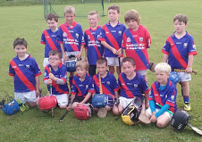
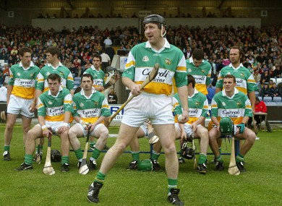
Our Aim
Drumcullen GAA

Slide 4
Coaching & Development Plan
Coaching & Development Committee
- Coaches at all levels (Hurling)
- TBC (Camogie)
Coaching & Development Officer
- Kieran Dooley (Hurling)
- Annmarie Guinan (Camogie)
School Liaison Officer
- Joe O’Brien (Hurling)
- TBC (Camogie)
Underage Structure
Qualified Coaches
- Access to Coaching Courses
Skills Pathway
Track & Measure Player improvement
Drumcullen GAA

Slide 5
Underage Structure
Nursery Level
- U-4/5
- U-6
- U-8
Non-Competitive Level
- U-10
- U-12
Competitive Level
- U-14
- U-16
- U-18
Grade | Ratio (Recommended)
U-4/5 | 3:1
U-6 | 4:1
U-8 | 4:1
U-10 | 4:1
U-12 | 5:1
U-14 | 6:1
U-16 | 6:1
U-18 | 6:1
Drumcullen GAA

Slide 6
Underage Structure
Nursery Level
U-4/5 (Boys & Girls)
Hurling & Camogie Joint Venture
Fun/Social Programme
Agility, Running, Jumping, Balance Exercise, Co-ordination
Develop Listening Skills, Encourage Respect, Social Skills
One session per week Approx. 30-40 Minutes Duration
Coach/Child Ratio: No More than 3:1
Course with Damian Young early 2016.
New Group
Drumcullen GAA

Slide 7
Underage Structure
Recommended Schedule
School Goals:
Promoting, Development. Identify, Communication, Club Link & Recruiting
Drumcullen GAA

Slide 8
Skills Pathway
U – 8 | U – 10 | U-12 | U-14 | U-16 | Minors
Grip, Ready lock and Swing | Strike from the hand (20-30m) | Strike from the hand (25-35m) (Also on the Run) | Strike from the hand (40-50m) (Also on the Run) | Strike from the hand (40-50m) (Shorten Grip on the Run) | Strike from the hand (50-60m) (Shorten Grip on the Run)
Ground Strike (8-12m) | Ground Strike (12-20m) | Ground Strike (20-32m) | Ground Strike (32-40m) | Lift and Strike | Lift & strike (On the Run)
Dribble / Flick to space | Hand Pass – Left and Right | Hand Pass – Three variations (3-5m) | Hand Pass – Three variations (6-8m on the run) | Hand Pass – Three variations (8-10m on the run) | Hand Pass – Three variations (10-12m on the run)
Frontal Ground Block | Frontal Block | Tackling – Blocking / Hooking | Tackling – Blocking / Hooking | Tackling – Blocking / Hooking/Flicking the ball away | Tackling – Blocking / Hooking/Flicking the ball away
Chest Catch (Body protected) | Over Head Catch (Hand protected) | Catching – Low, Chest, High | Catching – Low, Chest, High | Competing for the high ball / flick in the air | Competing for the high ball / flick in the air
Shoulder Clash – Tyre | Shoulder Clash | Ground Flick | Batting /Doubling –High Ball | Side Lines | Side Lines
Roll/Jab Lift | Stopping – High Ball / Batting | Soloing | Solo and strike of hurl | Free Taking | Free Taking
Drumcullen GAA

Slide 9
Measure & Track Skills
Identify the skills gap
Sharing General Knowledge of Players
Ensure no overlapping of skills developing
Track & Measure Progress
Benchmark against best Practise
A Players skills catalogue for each players
Drumcullen GAA

Slide 10
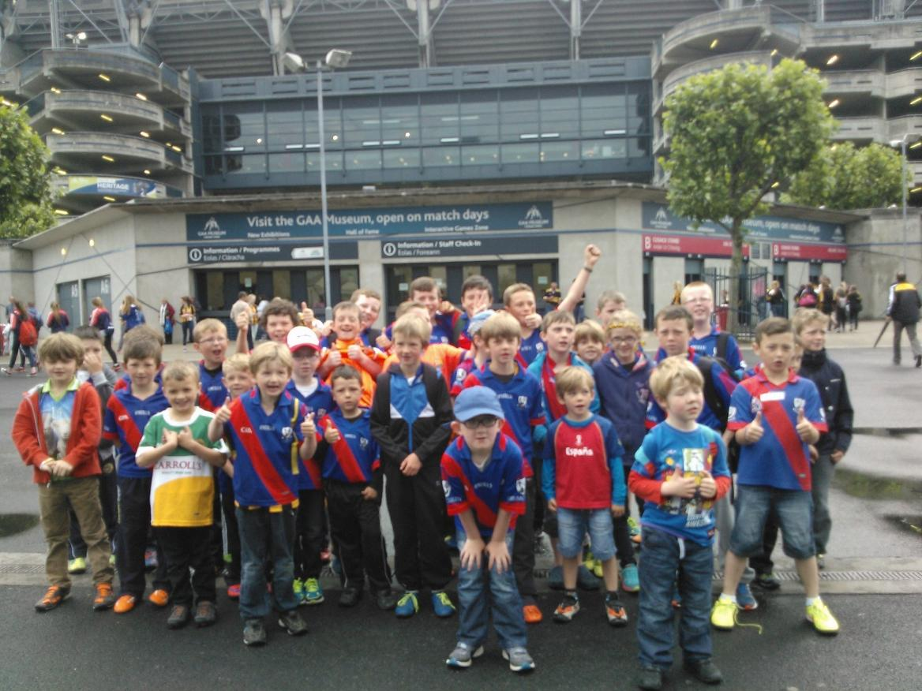
Measure & Track Skills
Thank You
Drumcullen GAA

